Slide 1
Video Display Devices
Dr. Aditya Raj

Slide 2
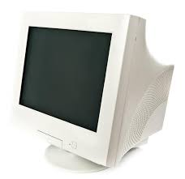

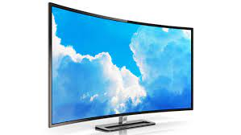
Video display devices
Historically - cathode-ray tube (CRT) design.
Recently - flat-panel displays.

Slide 3
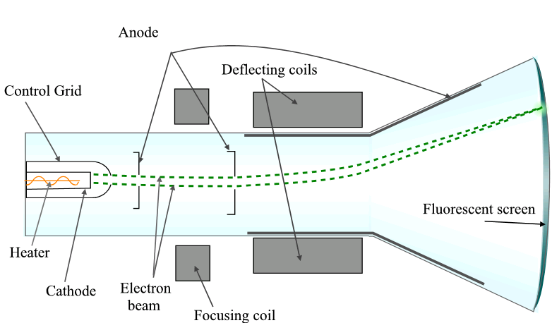
Refresh Cathode-Ray Tubes

Slide 4
Refresh Cathode-Ray Tubes
A beam of electrons (cathode rays), emitted by an electron gun, passes through focusing and deflection systems that direct the beam toward specified positions on the phosphor-coated screen.
The phosphor then emits a small spot of light at each position contacted by the electron beam.
Need for maintaining the screen picture, as the light emitted by phosphor-coated screen fades away.
Two way:
store the picture information as a charge distribution within the CRT.
redraw the picture repeatedly by quickly directing the electron beam back over the same screen points.

Slide 5
Refresh Cathode-Ray Tubes
Such device are called a refresh CRT.
Refresh rate: frequency at which a picture is redrawn on the screen.
Primary components of an electron gun in a CRT: the heated metal cathode and a control grid.
Heat is supplied to the cathode by directing a current through a coil of wire, called the filament, inside the cylindrical cathode structure.
This causes electrons to be “boiled off” the hot cathode surface.
In the vacuum inside the CRT envelope, the free, negatively charged electrons are then accelerated toward the phosphor coating by a high positive voltage.
The accelerating voltage can be generated with a positively charged metal coating on the inside of the CRT envelope near the phosphor screen, or an accelerating anode.

Slide 6
Refresh Cathode-Ray Tubes
Intensity of the electron beam is controlled by the voltage at the control grid.
Since the amount of light emitted by the phosphor coating depends on the number of electrons striking the screen, the brightness of a display point is controlled by varying the voltage on the control grid.
Focusing system in a CRT forces the electron beam to converge to a small cross section as it strikes the phosphor.
Focusing is accomplished with either electric or magnetic fields.
The distance that the electron beam must travel to different points on the screen varies because the radius of curvature for most CRTs is greater than the distance from the focusing system to the screen center.

Slide 7
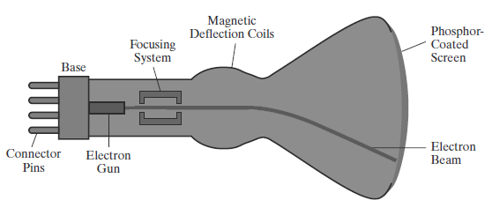
Refresh Cathode-Ray Tubes
As the beam moves to the outer edges of the screen, displayed images become blurred.
Deflection of the electron beam can be controlled with either electric or magnetic fields
Cathode-ray tubes are now commonly constructed with magnetic-deflection coils mounted on the outside of the CRT envelope.

Slide 8
Refresh Cathode-Ray Tubes
One pair of coils is mounted on the top and bottom of the CRT neck, and the other pair is mounted on opposite sides of the neck.
Result: transverse deflection force that is perpendicular to both the direction of the magnetic field and the direction of travel of the electron beam.
Similar arrangement of plates in case of electrostatic.
Properties of phosphorus: Color and Persistence.
The frequency (or color) of the light emitted by the phosphor is in proportion to the energy difference between the excited quantum state and the ground state.

Slide 9

Refresh Cathode-Ray Tubes
Persistence of phosphor coating is defined as the time that it takes the emitted light from the screen to decay to one-tenth of its original intensity.
Lower-persistence phosphors require higher refresh rates to maintain a picture on the screen without flicker. Application: Animation.
High-persistence phosphors are better suited for displaying highly complex, static pictures.
Resolution – the number of points per centimeter that can be plotted horizontally and vertically.
Spot intensity has a Gaussian distribution

Slide 10
Refresh Cathode-Ray Tubes
Two adjacent spots will appear distinct as long as their separation is greater than the diameter at which each spot has an intensity of about 60 percent of that at the center of the spot.
Spot size also depends on intensity.
As more electrons are accelerated toward the phosphor per second, the diameters of the CRT beam and the illuminated spot increase.
Resolution of a CRT is dependent on the type of phosphor, the intensity to be displayed, and the focusing and deflection systems.
Typical resolution on high-quality systems is 1280 by 1024.

Slide 11
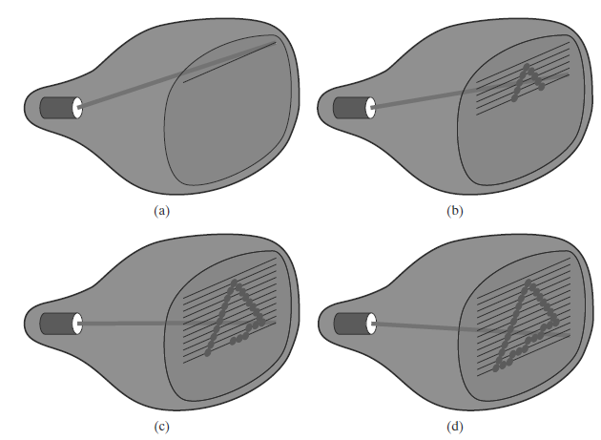
Raster scan display

Slide 12
Raster scan display (contd…)
Deploys CRT technique.
The electron beam is swept across the screen, one row at a time, from top to bottom – Each row is called Scan line.
As the electron beam moves across a scan line, the beam intensity is turned on and off (or set to some intermediate value) to create a pattern of illuminated spots.
Refresh buffer or frame buffer or color buffer – memory location where picture definition is stored.
Frame – is the total screen area.
Pixel or pel (picture element) – each screen spot that is illuminated by electron beam.

Slide 13
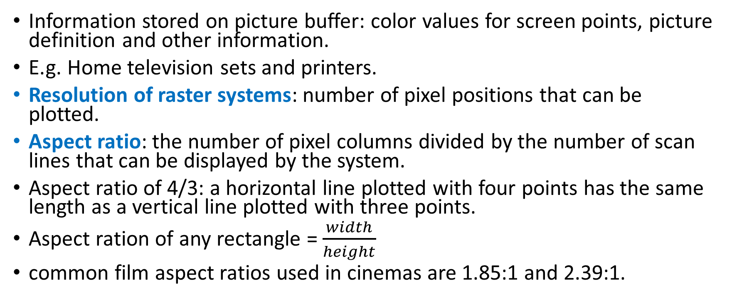
Raster scan display (contd…)
Information stored on picture buffer: color values for screen points, picture definition and other information.
E.g. Home television sets and printers.
Resolution of raster systems: number of pixel positions that can be plotted.
Aspect ratio: the number of pixel columns divided by the number of scan lines that can be displayed by the system.
Aspect ratio of 4/3: a horizontal line plotted with four points has the same length as a vertical line plotted with three points.
Aspect ration of any rectangle = $\frac{width}{height}$
common film aspect ratios used in cinemas are 1.85:1 and 2.39:1.

Slide 14
Raster scan display (contd…)
For the x:y aspect ratio, the image is x units wide and y units high.
 | Common aspect ratio
Cinemas | 1.85:1 or 2.39:1
Videography | 4:3 or 1.33:1
TV photography | 4:3 (universal) or 16:9 (HD TV)
Still camera photography | 4:3 or 3:2

Slide 15
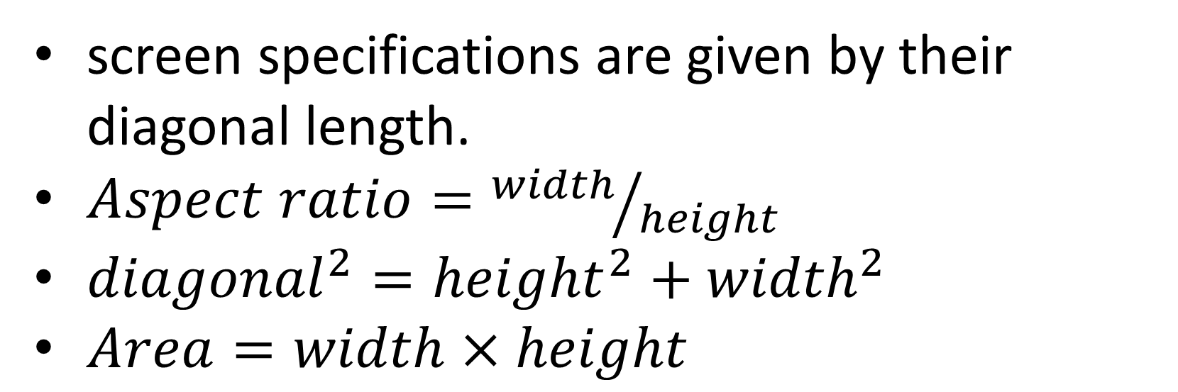
Raster scan display (contd…)
screen specifications are given by their diagonal length.
$Aspect ratio={width}/{height}$
${diagonal}^{2}={height}^{2}+{width}^{2}$
$Area=width×height$

Slide 16
Raster scan display (contd…)
Range of colors or shades of gray displayed: depends on both the types of phosphor used in the CRT and the number of bits per pixel available in the frame buffer.
Black and white system: each screen point is either on or off, so only 1 bit per pixel is required to control the intensity.
Up to 24 bits per pixel are included in high-quality systems.
E.g. A system with 24 bits per pixel and screen resolution of 1024 by 1024 require how much storage of frame buffer?
Depth of the buffer area: number of bits per pixel in a frame buffer.
Bitmap: A frame buffer with 1 bit per pixel.

Slide 17
Raster scan display (contd…)
Pixmap: a frame buffer with multiple bits per pixel.
Screen refreshing => We see each frame as smooth continuation of patterns in previous frame.
Less than 24 frames/second: Flickering.
current raster-scan displays – Refreshing @ 60 to 80 frames per second (or 60 to 80 Hertz).
Horizontal retrace of beam: The return of electron beam to the left of the screen at the end of each scan line.
Vertical retrace: at the end of each frame, the electron beam returns to the upper-left corner of the screen to start the new frame.

Slide 18
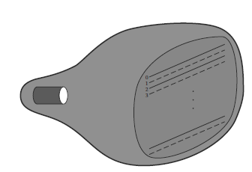
Raster scan display (contd…)
Interlaced refresh procedure: First, all points on the even-numbered (solid) scan lines are displayed; then all points along the odd-numbered (dashed) lines are displayed.
allows us to see the entire screen displayed in half the time.
an effective technique for avoiding flicker—provided that adjacent scan lines contain similar display information.

Slide 19
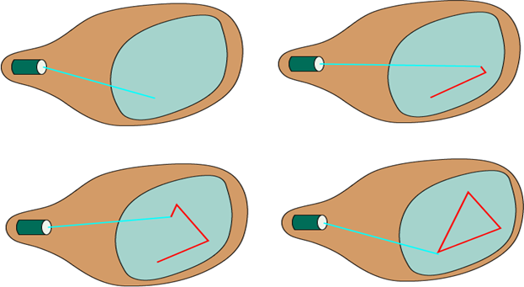
Random scan display (contd…)

Slide 20
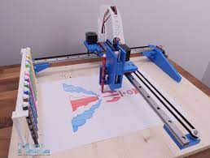
Random scan display (contd…)
Here the CRT has the electron beam directed only to those parts of the screen where a picture is to be displayed.
Also referred to as vector displays (or stroke-writing displays or calligraphic displays).
Refreshing is done in any specified order.
E.g. Pen plotter.
Refresh rate on a random-scan system depends on the number of lines to be displayed on that system.

Slide 21
Random scan display (contd…)
Picture definition is stored as a set of line-drawing commands in an area of memory referred to as the display list/refresh display file/ vector file/display program.
After all line-drawing commands have been processed, the system cycles back to the first line command in the list.
Application of such systems: line-drawing applications.
Have higher resolutions than raster systems.
produce smooth line drawings, as opposed to raster system, because the CRT beam directly follows the line path.

Slide 22
Color CRT Monitors
displays color pictures by using a combination of phosphors that emit different-colored light.
The emitted light from the different phosphors merges to form a single perceived color, which depends on the particular set of phosphors that have been excited.
Beam-penetration method:
coat the screen with layers of different colored phosphors.
emitted color depends on how far the electron beam penetrates into the phosphor layers.
typically used only two phosphor layers: red and green.
Beam of slow electrons: excites outer red layer.
Beam of very fast electrons: excites both red and green layer.
Intermediate speed???

Slide 23
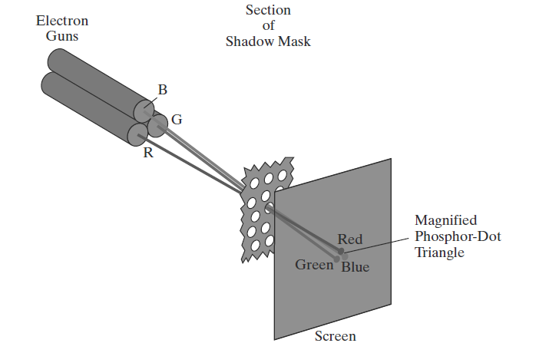
Color CRT Monitors
Screen color at any point ➔ Speed of electron: controlled by beam acceleration voltage.
Advantage: Inexpensive method.
Disadvantage: limited possible color, poor quality picture
Shadow mask method:
Wide range of colors produced.
uses three phosphor color dots at each pixel position, each for RGB light.
CRT has three electron guns, one for each color dot, and a shadow-mask grid just behind the phosphor-coated screen.

Slide 24
Color CRT Monitors
Three electron guns, aligned with the triangular color-dot patterns on the screen, are directed to each dot triangle by a shadow mask.
The three electron beams are deflected and focused as a group onto the shadow mask, which contains a series of holes aligned with the phosphor-dot patterns.
The phosphor dots in the triangles are arranged so that each electron beam can activate only its corresponding color dot when it passes through the shadow mask.
Color variations in a shadow-mask CRT by varying the intensity levels of the three electron beams.

Slide 25

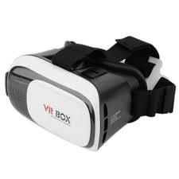
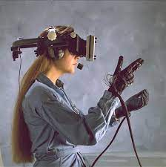
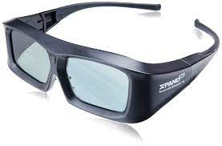
Other output devices
Input devices
Flat panel displays
3-D viewing displays
Virtual Reality systems
Keyboard
Button boxes
Space-balls
Joysticks
Data gloves
Light pens
Touch panels

